Slide 1

In Memoriam
Altrusa International District Three
2025 - 2026

Slide 2
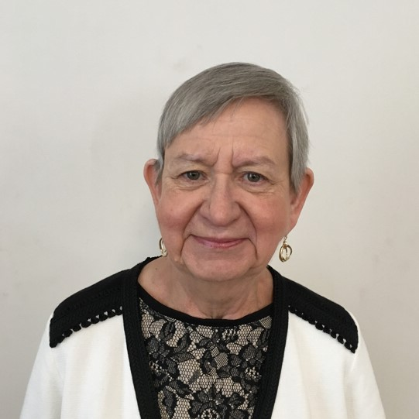
Carole Anne Oglesby
Altrusa International
of Gainesville, FL
Age 79
August 9, 2025

Slide 3
Slide 3
Carole’s
Contributions to Altrusa and this club
Carole became a member of the Altrusa International of Gainesville club in 1994. She served as editor of the Gainesville Club Newsletter for many years. Carole served as First Vice President 2015-2016.
By Dee Dugger, President

Slide 4
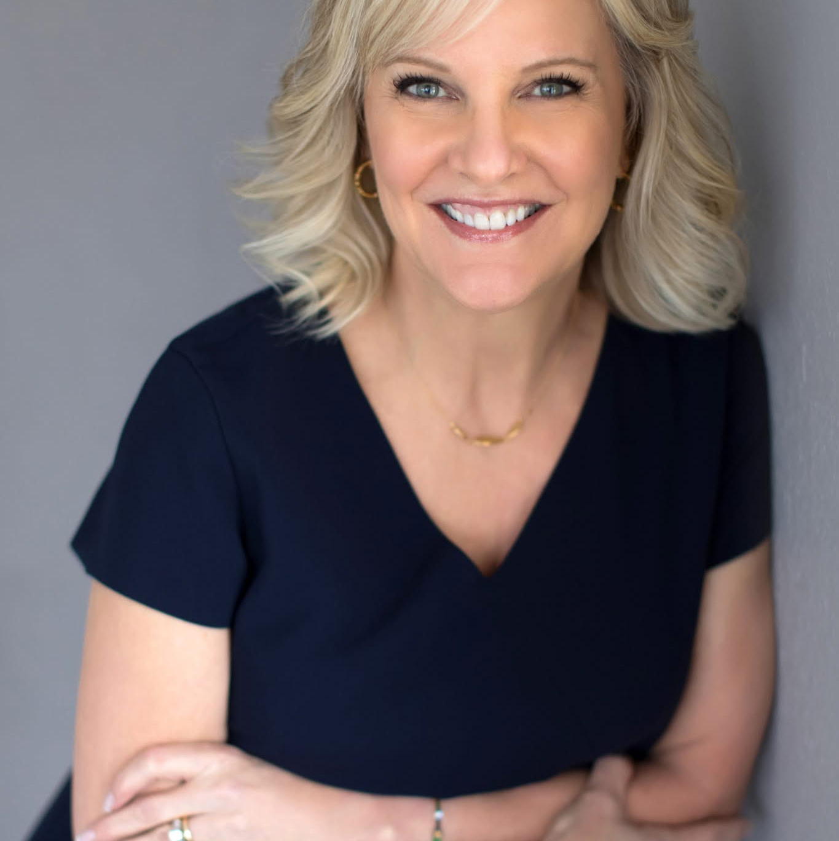
Teresa Morgan
Altrusa International of Lake City, FL
Age 69
August 12, 2025

Slide 5
Slide 3
Teresa.s
Contributions to Altrusa and this club
Teresa Byrd Morgan became a member of the Altrusa International of Lake City, FL club in 1994 and was President in 2001-2002 and Altrusan of the Year in 2014-2015. She was Co-chair of “Get Fit Lake City” a project that encouraged healthier lifestyles in Columbia County through nutrition and weight management.
Teresa had been practicing law for over 35 years and was the founder and managing partner of Morgan & Getzan, PLLC, an estate planning and elder law firm in Lake City, Florida. During her career, Teresa has been an active member of WealthCounsel, Elder Counsel, the National Network of Estate Planning Attorneys, the James C. Adkins Inn of Court, and the SunBridge Legacy Builder Network. She had lectured on estate planning, elder law, and law firm practice management throughout the country. Her legal activities and Honors were amazing from 1993 to present.
By Sandy Thompson, President

Slide 6
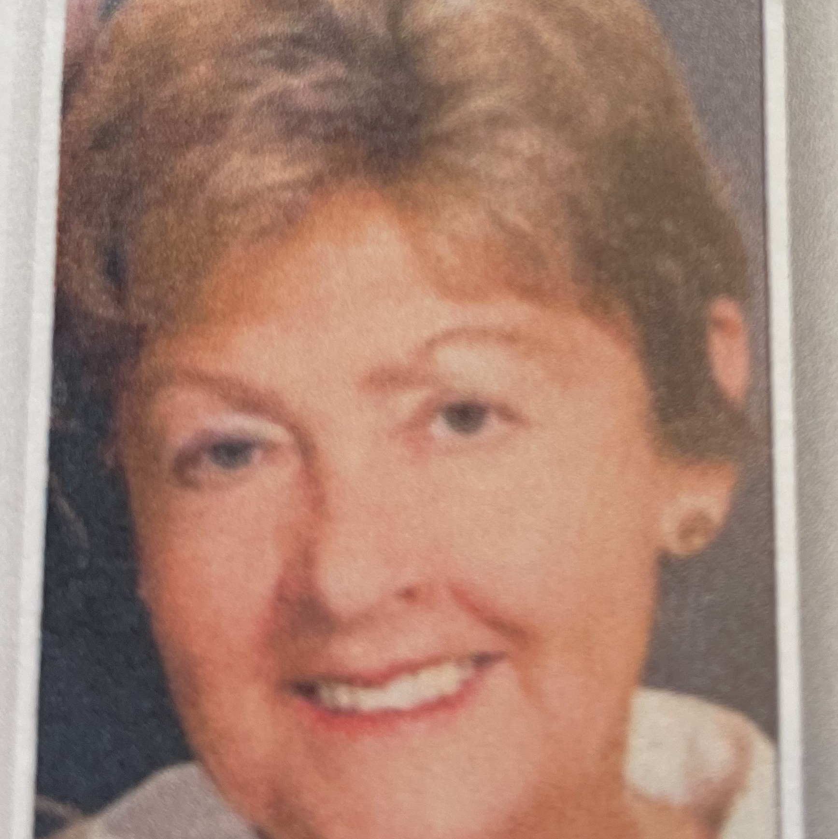
Marianne Miller
Altrusa International
of Monticello, fl
Age 82
November 24, 2025

Slide 7
Slide 3
Marianne’s
Contributions to Altrusa and this club
Marianne, a member of Altrusa International of Monticello, FL since 2014 never knew a stranger and was a true ambassador for Altrusa. Her love of reading fueled her support and contributions to the club’s efforts in spreading literacy throughout her community and beyond. She was always ready to host a meeting and serve on Literacy, Service and Care committees; and she willingly joined any work project undertaken by the club. Marianne’s legacy of compassion, friendship and unwavering love will live on in the countless lives she touched.
By Patricia Cichon, President

Slide 8
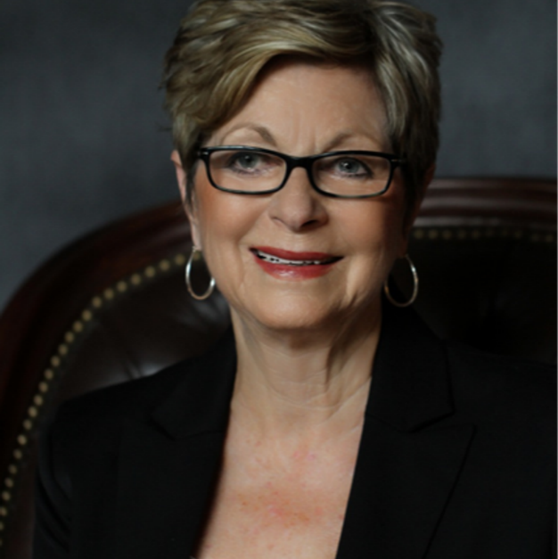
Norma Teuton
Altrusa International North Georgia, GA
Age 84
September 13, 2025

Slide 9
Slide 3
Norma’s
Contributions to Altrusa and this club
Norma’s commitment and devotion to Altrusa began in 2001 when she attended a meeting of the Marietta-Cobb Club. In true Altrusa fashion, she didn’t just join Altrusa, she became an Altrusan who quickly moved into leadership roles as membership chair, vice president and president.
She was instrumental in the formation of the North Georgia club in 2005 and for more than 15 years, she graciously and generously filled many roles-mentor, resource, volunteer, cheerleader and recruiter.
She served six years as president, also launching and editing the club newsletter and chairing the literacy committee. She spearheaded the club’s establishment of annual fundraiser to provide scholarships for non-traditional students at a local technical college that has raised more than $60,000.
Norma also gave her time and talents at the district level. She chaired the membership and new club building committees. Co-chaired the planning committee for two district conferences and was a member of the nominating committee. She served as a director on the District Three Board, District Governor Elect and District Governor for the 2015 biennium.
She later sat as a director on the Altrusa international Board from 2019-2021 and presided as new club building chair on the international membership development committee.
The theme for her biennium as Governor was “Together, We Make a Difference”. Norma truly made a difference.
By Penny A. Penn, North Georgia, GA club member

Slide 10
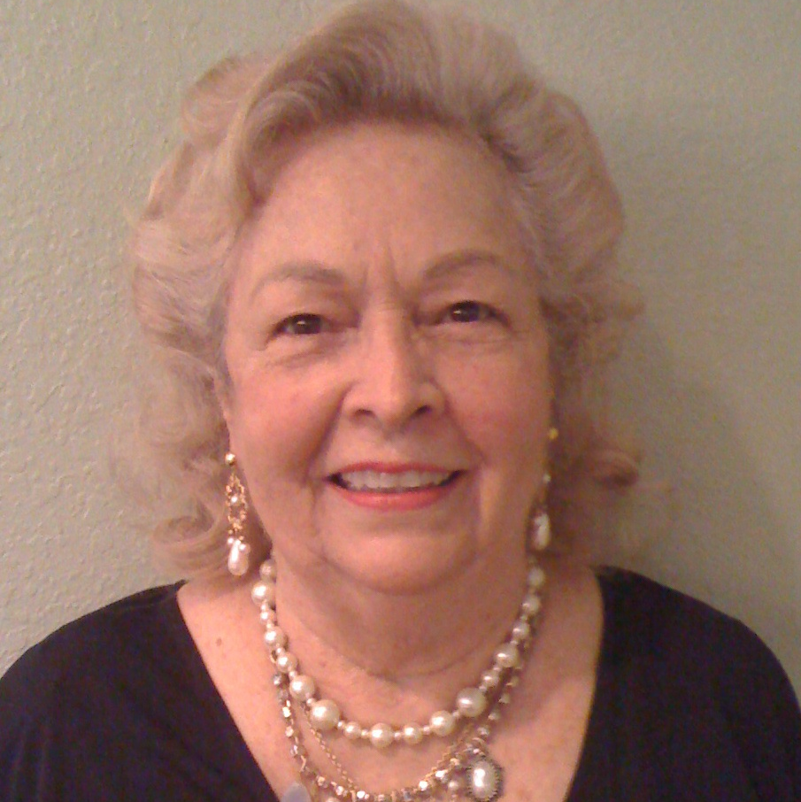
Betty Cluster
Altrusa International
of Ocala, FL
Age 92
February 1, 2026

Slide 11
Slide 3
Betty’s
Contributions to Altrusa and this club
Betty became a member of Altrusa International of Ocala, FL in 1987 and received Emeritus status in 2023. A former employee of the Marion County School Board, she contributed to the club through her support of all the fundraisers and service projects. She was dedicated to education and literacy. She was a member of the ASTRA, Literacy, Community Service and Long Range Planning committees throughout her time of membership.
By Colleen Duris, Immediate Past President

Slide 12
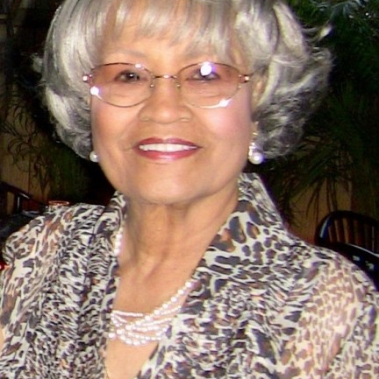
Juanita P. Cunningham
Altrusa International
of ocala, fl
Age 100
August 13, 2025

Slide 13
Slide 3
Juanita’s
Contributions to Altrusa and this club
Juanita was a local icon revered as an inspiring educator and a mentor, advocate and role model for generations of Ocala residents. She was a charter member of Altrusa International of Ocala in 1977 and she conceived the Altrusa Read-In for Literacy, the club’s signature service project for 25 years. Through the program every elementary classroom in Marion County hosted a guest reader on the same day at the same time. For all her contributions to Altrusa she was named Altrusan of the Year in 1990; had a scholarship named in her honor and has a bookshelf at the Tools 4 Teaching store at the Marion County Public Education Foundation, where the club still supplies books for students all year long.
By Colleen Duris, Immediate Past President

Slide 14
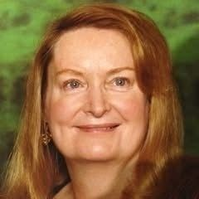
Dianne Patterson
Altrusa International
Virtual CLub
Age 80
June 29, 2025

Slide 15
Slide 3
Dianne’s
Contributions to Altrusa and this club
Diane, an Altrusa member since 2005 was involved heavily in community service specifically work with the Back-Pack Angels, Purple Playas, and The Learning Center. She initiated a Positive Behavior Support system program at the University of South Florida preschool site. Her commitment to education and literacy was strong. She made a positive difference in her community and will be greatly missed
By Judy Perkin, President

