Slide 1
73rd ANNUAL
DISTRICT THREE
CONFERENCE
Awards Ceremony

Slide 2

Recognition of
25-Year Members

Slide 3
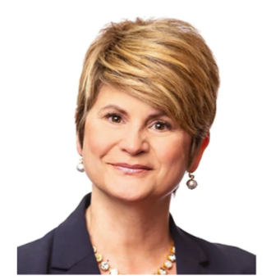
25 YEARS as an ALTRUSAN
Jill Adams
Altrusa International
of Lake City, FL

Slide 4
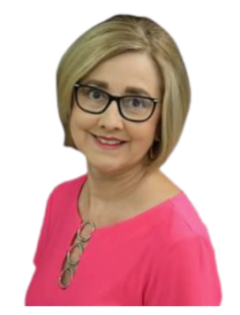
25 YEARS as an ALTRUSAN
Durelle Bailey
Altrusa International
of Lake City, FL

Slide 5
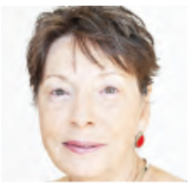
25 YEARS as an ALTRUSAN
Wanda Toner
Altrusa International
of Lake City, FL

Slide 6
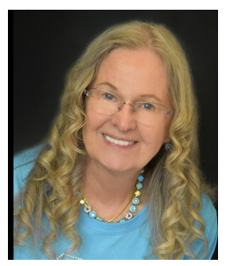
25 YEARS as an ALTRUSAN
Kitty McElhaney
Altrusa International
of Lake City, FL

Slide 7
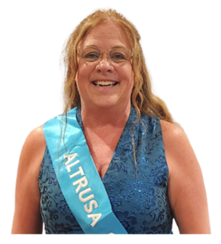
25 YEARS as an ALTRUSAN
Lori Wheeler
Altrusa International
of Lake City, FL

Slide 8
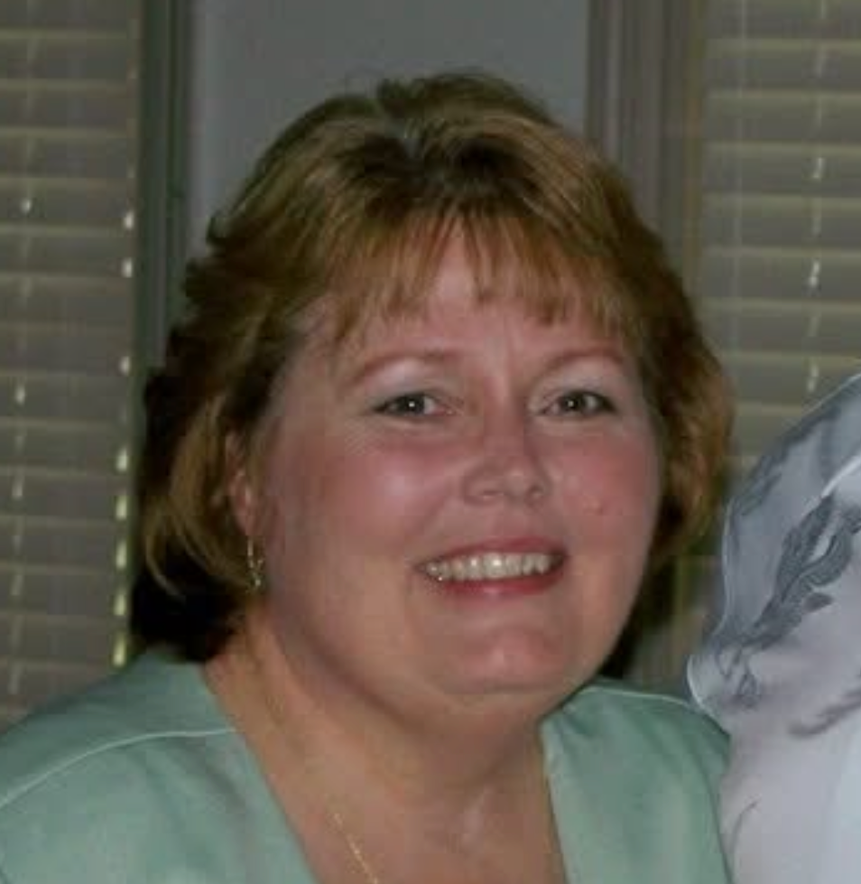
25 YEARS as an ALTRUSAN
Carole DeCelle
Altrusa International
of Starke, FL

Slide 9
Recognition of
50-Year Members

Slide 10
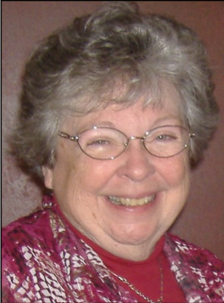
50 YEARS as an ALTRUSAN
Linda Walker
Altrusa International
of Spartanburg, SC

Slide 11
SPONSOR PIN RECIPIENTS:
1 – Jennifer Drumm, Charlotte, NC
1 – Karen Fellows, Citrus County, FL
5 – Susan Gill, Citrus County, FL
1 – Holli Herndon, Citrus County, FL
1 – Melissa Sutherland, Citrus County, FL
1 – Emily Pazel, District Three Virtual Club
1 – Judy Perkin, District Three Virtual Club
1 – Wafa Berbari, Gainesville, FL
1 – Virginia Pearcy, Gainesville, FL
5 – Rebecca Golden, Lake City, FL
5 – Debra Griffin, Lake City, FL
1 – Abby Stalvey, Lake City, FL
5 – Shellie Young, Lake City, FL
5 – Anita Valdez, Lake County, FL
1 – Cathy Keller, Lake County, FL
1 – Patricia Mueller, Lake County, FL
1 – Carol Hingson, Live Oak, FL
1 – Rose Cavin, Mariana, FL
1 – Lauren Cowan, Mariana, FL
1 – Becky Hart, Mariana, FL
1 – Edna Riley, Mariana, FL
1 – Maggie Edmiston, North Georgia, GA
GA – Nancy Simms, North Georgia, GA
1 – Becky Long, Ocala, FL
1 – Judi Zanetti, Ocala, FL
1 – Dawn Jones, Orlando-Winter Park, FL
1 – Charlotte Simpson, Orlando-Winter Park, FL
GA – Elizabeth Sushinsky, Orlando-Winter Park, FL
1 – Cynthia Johnson, Spartanburg, SC
1 – Linda Herrera, St. Augustine, FL
5 – Jill Nevil, Statesboro, GA

Slide 12
Altrusa District Three
Awards

Slide 13
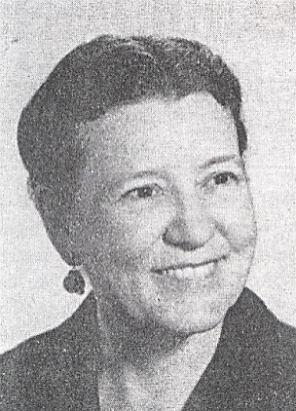
Ernestine Milner Program
Excellence Award
Altrusa International of Charlotte, NC
Altrusa International of Gainesville, FL
Altrusa International of Lake City, FL
Altrusa International of North Georgia, GA
Altrusa International of Ocala, FL
Altrusa International of Orlando-Winter Park, FL
Altrusa International of Raleigh, NC
Altrusa International of Starke, FL

Slide 14
Ernestine Milner Program Excellence Award
Third Place: Altrusa International of Charlotte, NC and Altrusa International of Starke, FL
(151 points)
Second Place: Altrusa International of Lake City, FL
(159 points)

Slide 15
Ernestine Milner Program Excellence Award
First Place:
Altrusa International of Gainesville, FL
(175 points)

Slide 16
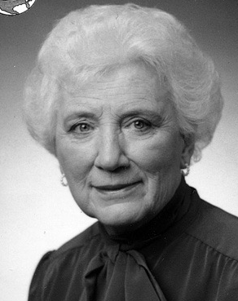

Todd Jordan Yearbook Submissions
Altrusa International of Charlotte, NC
Altrusa International of Gainesville, FL
Altrusa International of Lake City, FL
Altrusa International of Lake County, FL
Altrusa International of North Georgia, GA
Altrusa International of Ocala, FL
Altrusa International of Orlando-Winter Park, FL
Altrusa International of Raleigh, NC
Altrusa International of Spartanburg, SC
Altrusa International District Three Virtual Club

Slide 17
Congratulations to our Todd Jordan Yearbook Award Recipients!

Slide 18
Newsletter Award
Altrusa International of Gainesville, FL
Altrusa International of Lake City, FL
Altrusa International of Lake County, FL
Altrusa International of Ocala, FL
Altrusa International of Raleigh, NC
Altrusa International of Spartanburg, SC
Altrusa International of Starke, FL
Altrusa International District Three Virtual Club

Slide 19
Newsletter Award
Third Place:
Altrusa International District Three Virtual Club
“Virtual Vibes” (207 points)
Second Place:
Altrusa International of Starke, FL
“The Splendid Type” (227 points)

Slide 20
Newsletter Award
First Place:
Altrusa International of Lake County, FL
“High Heels with High Ideals” (251 points)

Slide 21
Community Service Submissions
Altrusa International of Charlotte, NC
Altrusa International of Gainesville, FL
Altrusa International of Lake City, FL
Altrusa International of Lake County, FL
Altrusa International of North Georgia, GA
Altrusa International of Ocala, FL
Altrusa International of Orlando-Winter Park, FL
Altrusa International of Raleigh, NC
Altrusa International of Starke, FL
Altrusa International District Three Virtual Club

Slide 22
Outstanding Community Service Award
Total volunteer hours: 11,071
Total Funds Donated or Spent by Clubs: $140,861
Most community service hours:
Altrusa International of Lake City, FL: 3,664
Most community service hours per member:
Altrusa International of Raleigh, NC: 59.1
Highest community service dollars:
Altrusa International of Lake City, FL: $27,269

Slide 23
Congratulations to our Community Service Recognition Recipients!

Slide 24
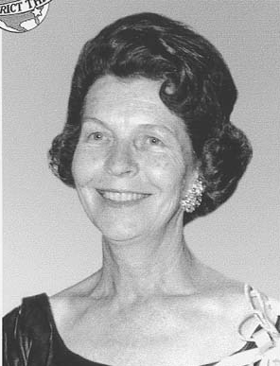
Myrtice H. Price Membership Award
Greatest Percentage Membership Net Gain:
From February 1, 2025
Through January 31, 2026

Slide 25
Greatest Percentage Net Gain
Third Place: With a 25.0% gain,
Altrusa International of
North Georgia, GA - $27.16
Second Place: With a 26.3% gain,
Altrusa International of Marianna, FL - $40.73

Slide 26
Greatest Percentage Net Gain
First Place: With a 42.9% gain,
Altrusa International of
Citrus County, FL - $67.89

Slide 27
Myrtice H. Price Membership Award
Membership Greatest
Net Gain:
From February 1, 2025
Through January 31, 2026

Slide 28
Membership Greatest Net Gain
Third Place:
With a net gain of 6 members:
Altrusa International of
Citrus County, FL

Slide 29
Membership Greatest Net Gain
Second Place:
With a net gain of 9 members:
Altrusa International of
North Georgia, GA

Slide 30
Membership Greatest Net Gain
First Place:
With a net gain of 12 members Altrusa International of
Lake City, FL

Slide 31
Myrtice H. Price Membership Award
Membership Incentive Credit:
From February 1, 2025
Through January 31, 2026

Slide 32
Membership Incentive Credit
3-5 Members . . . . . . . . . . . . . . . . . $25.00
Net gain of 3 members - Gainesville, FL * Ocala, FL * Orlando-Winter Park, FL * District Three Virtual Club
Net gain of 4 members - Lake County, FL * Statesboro, GA
Net gain of 5 members - Marianna, FL

Slide 33
Membership Incentive Credit
6-8 Members . . . . . . . . . . . . . . . . . $50.00
Net gain of 6 members – Citrus County, FL

Slide 34
Membership Incentive Credit
9-11 Members . . . . . . . . . . . . . . . . . $75.00
Net gain of 9 members – North Georgia, GA

Slide 35
Membership Incentive Credit
12+ Members . . . . . . . . . . . . . . . . . $100.00
Net gain of 12 members – Lake City, FL

Slide 36
PRESENTATION OF
Altrusa International
Awards

Slide 37
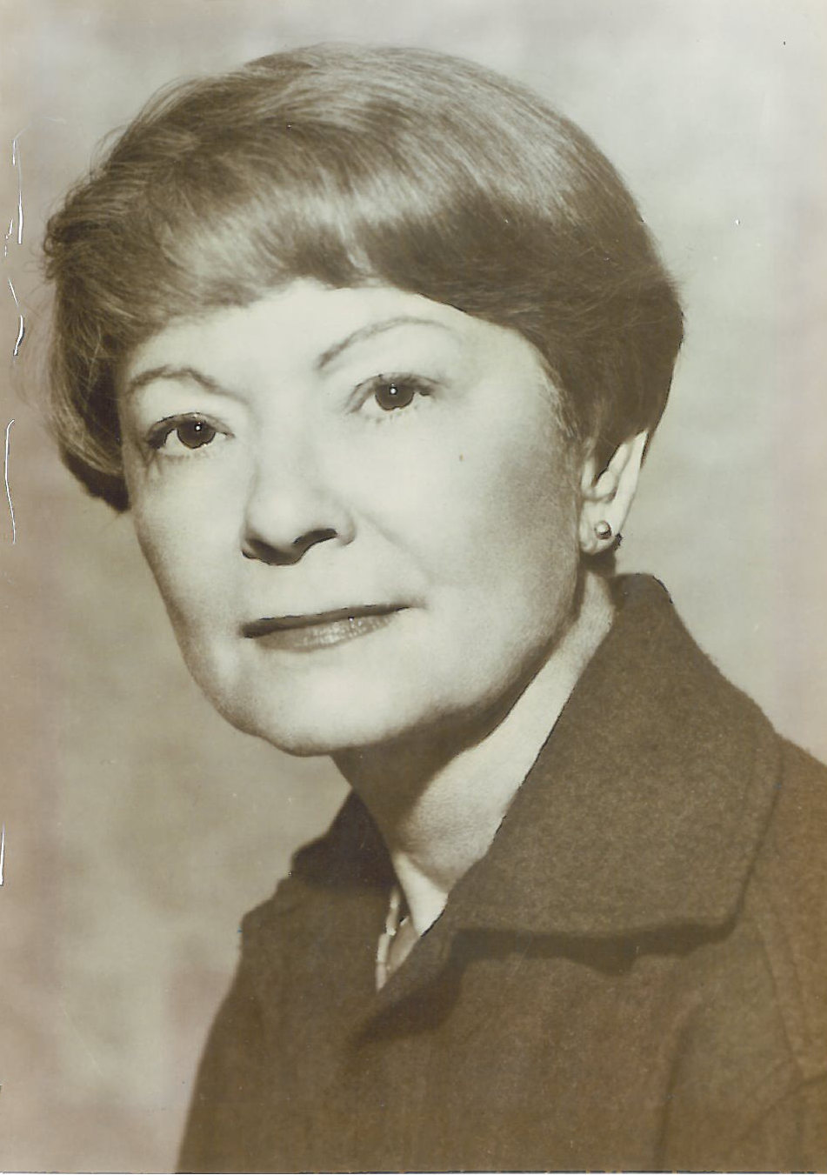
  Letha H. Brown
        Literacy Award
Altrusa International of Charlotte, NC
Altrusa International of Lake City, FL
Altrusa International of Lake County, FL
Altrusa International of North Georgia, GA
Altrusa International of Ocala, FL
Altrusa International of Orlando-Winter Park, FL
Altrusa International of Starke, FL

Slide 38
Letha H. Brown Literacy Award
Third Place:
Altrusa International of Charlotte, NC
Project: “Ronald’s Cozy Corner” (249 pts)
Second Place:
Altrusa International of Lake County, FL
Project: “Give Kids the World” (254 pts)

Slide 39
Letha H. Brown Literacy Award
First Place:
Altrusa of North Georgia, GA
Project: “Got Books? Our Kids Do!” (255 points)

Slide 40
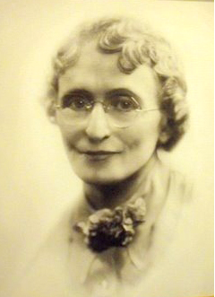
Mamie L. Bass Service Award
Altrusa International of Charlotte, NC
Altrusa International of Gainesville, FL
Altrusa International of Lake City, FL
Altrusa International of Lake County, FL
Altrusa International of North Georgia, GA
Altrusa International of Orlando-Winter Park, FL
Altrusa International of Raleigh, NC
Altrusa International of Starke, FL
Altrusa International District Three Virtual Club

Slide 41
Mamie L. Bass Service Award
Third Place:
Altrusa International of Raleigh, NC
Project: “Clothing with Dignity and Love” (239 pts)

Slide 42
Mamie L. Bass Service Award
Second Place:
Altrusa International of Lake County, FL
Project: “Delivering the Difference” (241 pts)

Slide 43
Mamie L. Bass Service Award
First Place:
Altrusa International of Charlotte, NC
Project: “Lifting Hearts & Minds at Lebanon Road Elementary School!”
(268 points)

Slide 44
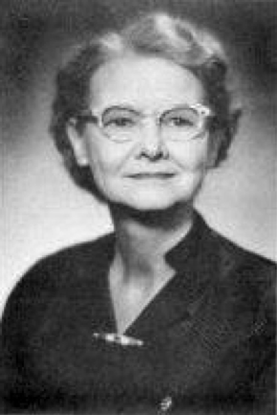
Dr. Nina Fay Calhoun
International Relations Award
Altrusa International of Charlotte, NC

Slide 45
Dr. Nina Fay Calhoun
International Relations Award
First Place:
Altrusa International of Charlotte, NC
Project: “Small Outlays with Maximum Impact”
(202 pts)

Slide 46
Governor’s Awards and
Recognitions

Slide 47
Biennium Goals Recognition

Slide 48

Biennium Theme:
“Bee Essential”

Slide 49
Biennium Goals:
Leadership
Service
Membership

Slide 50
Leadership Recognition
Club Presidents

Slide 51
Governor’s
Outstanding Club
Award

Slide 52
Governor’s Outstanding Club Award
Altrusa International of Charlotte, NC
Altrusa International of Gainesville, FL
Altrusa International of Lake City, FL
Altrusa International of Lake County, FL
Altrusa International of Monticello, FL
Altrusa International of North Georgia, GA
Altrusa International of Ocala, FL
Altrusa International of Orlando-Winter Park, FL
Altrusa International of Raleigh, NC
Altrusa International of Spartanburg, SC
Altrusa International of Starke, FL
Altrusa International of St Augustine, FL
Altrusa International District Three Virtual Club

Slide 53
Governor’s Outstanding Club Award
3rd Place:
Altrusa International of
Orlando-Winter Park, FL – 360 pts
2nd Place:
Altrusa International of
Charlotte, NC – 371 pts

Slide 54
Governor’s Outstanding Club Award
1st Place Winner:
Altrusa International of Lake City, FL – 418 points!

Slide 55
Congratulations to all clubs for a year of outstanding work for their communities.
You make us proud!

