Slide 1

Altrusa District Three Foundation Awards 2025
Seven Clubs Submitted 20 Award Applications
Notes:
I am very happy to present the 2025 District Three Foundation Awards. This year we had 7 clubs submit 20 applications, which is an increase from 15 submissions last year. I know that the judges had a difficult time deciding the winners, since all of the projects were outstanding.

Slide 2
Altrusa District Three Foundation Awards
Clubs Who Submitted
Charlotte, NC
Gainesville, FL
Lake City, FL
Lake County, FL
Raleigh, NC
Spartanburg, SC
Starke, FL

Slide 3
Entries Submitted for Consideration
Charlotte, NC
  Filling in the Gap!
  Banishing Book Deserts
  A Little Bit of Faith
  Celebrating with a Purpose
Gainesville, FL
  Displaced Homemaker Program
  Boo at the Zoo Book Give away
Lake City, FL
  Expanding Hope-Mi Esperanza
  Make a Difference Day-Fall Into Reading

Slide 4
Entries Submitted for Consideration
Lake City, FL
  Full Tummies, Full Attention: Backpack Project
  Happy House Garden Revitalization Project
  RSGA Red Carpet Event
Lake County, FL
  “Bag Recycling” – A Cleaner Future for Florida
  Brighter Futures
  Read to Succeed

Slide 5
Entries Submitted for Consideration
Raleigh, NC
  Multi-Generation Literacy Project
  Wake County VIPs (Visually Impaired Persons)
  Engaging Our Community to Recycle Hazardous Waste
Spartanburg, SC
  The Eula Sherman Vocational Scholarship
Starke, FL
  G.E.D. Service Project
  Christmas Carnival Literacy Project

Slide 6
Lucile Spillers Alexander ASTRA Award
1st Place
147 Points
Lake City, Florida
RSGA Red Carpet Event
The award will be submitted to International for consideration
Notes:
Approximately 150 sixth grade students, who will be new to Richardson Sixth Grade Academy, attended a fun filled morning. The event began with a presentation by the RSGA Cheer and Dance Teams, followed by the school Principal welcoming the incoming students. The students played games and lunch was served. 17 Altrusans and 4 members of the school’s ASTRA club members volunteered for this event.
This award will be submitted to International for consideration.
Congratulations to Lake City

Slide 7
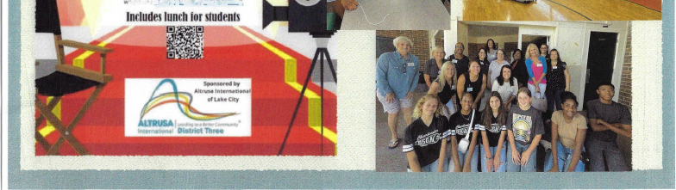
Notes:
Here is photo from the event

Slide 8
Richard Ward Ulrich Environmental Service Award
3rd Place
Lake City, Florida
302 Points
Happy House Garden Revitalization Project
Notes:
Altrusa International of Lake City partnered with Happy House, Inc., a fellow non-profit, to provide a hands-on garden/growing project for children 4-5 years old in Columbia County. The volunteers provided instruction to 14 children in how to grow plants and flowers.
Congratulations to Lake City

Slide 9
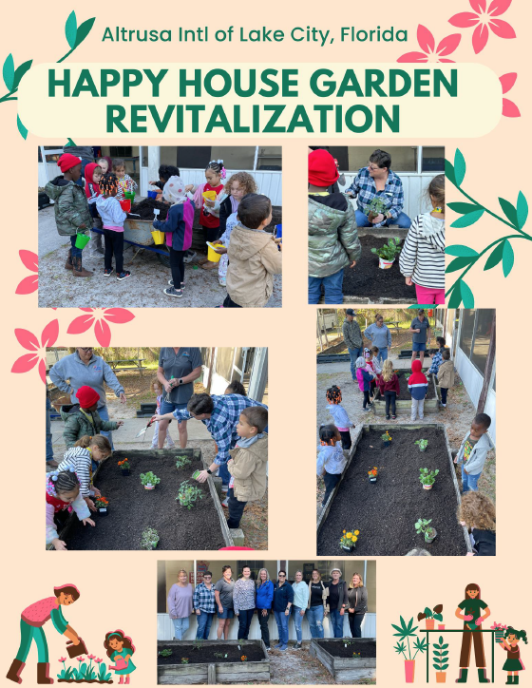

Slide 10
Richard Ward Ulrich Environmental Service Award
2nd Place
Raleigh, North Carolina
351 Points
Engaging Our Community to Recycle Hazardous Waste
Notes:
After touring the Wake County Landfill, the Raleigh club decided to collect and recycle batteries, later adding on hazardous chemicals and small electronics to help keep hazardous materials out of the landfill. They also learned how important it is to keep hazardous materials out of curbside recycling.
Congratulations to Raleigh

Slide 11
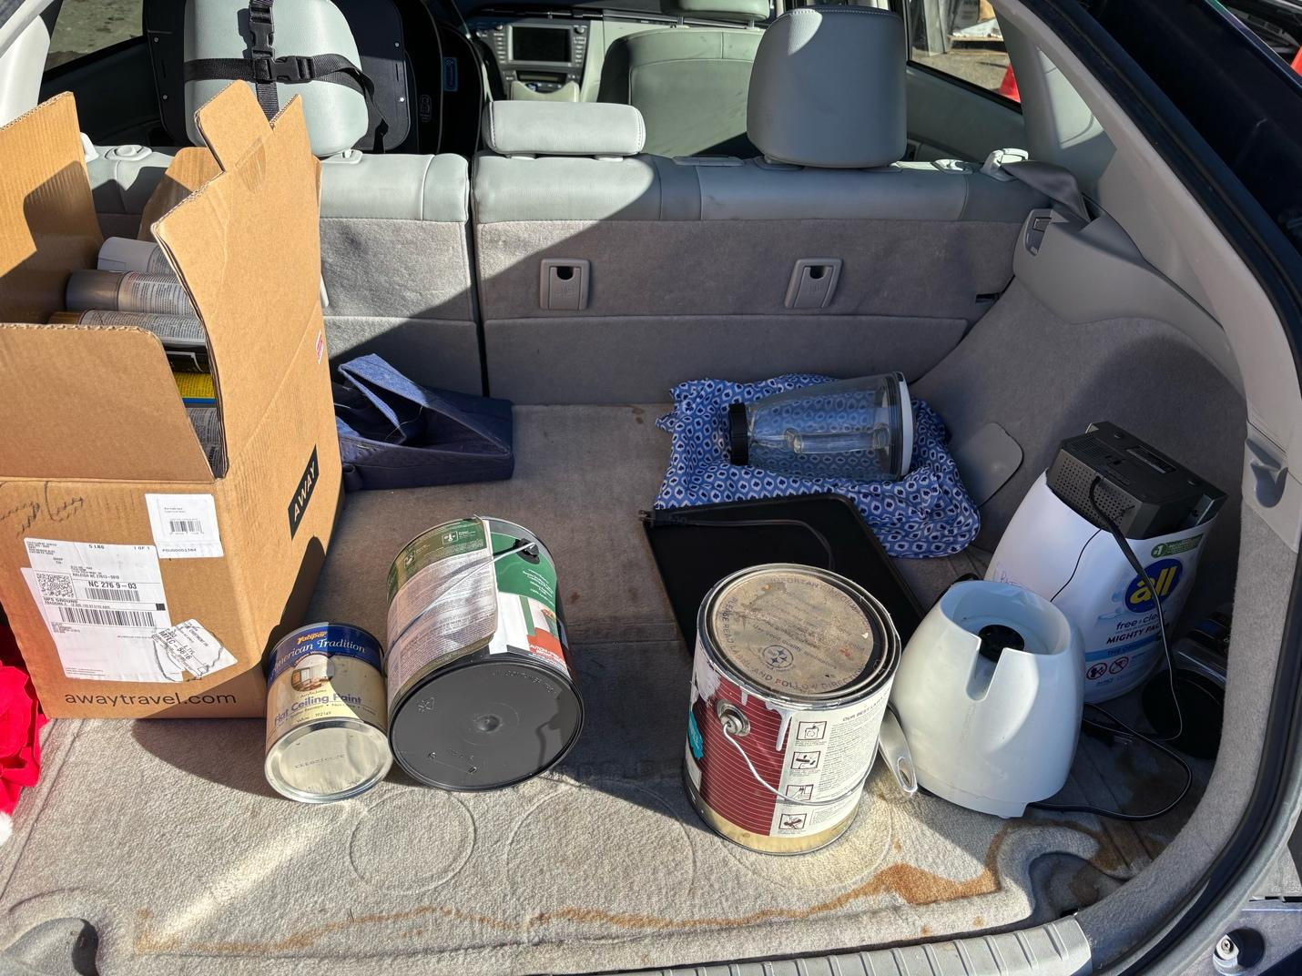

Slide 12
Richard Ward Ulrich Environmental Service Award
1st Place
Lake County, Florida
355 Points
“Bag Recycling” - A Cleaner Future for Florida
Notes:
It can take 1,000 years for plastic bags to degrade in a landfill. With one in seven plastic bags recycled, to be part of the solution, the Lake County club created their “bag recycling” project. Recycling to eliminate microplastic pollution in our environment, they turned 3,700 plastic bags into mats for the Homeless.
Congratulations to Lake County

Slide 13
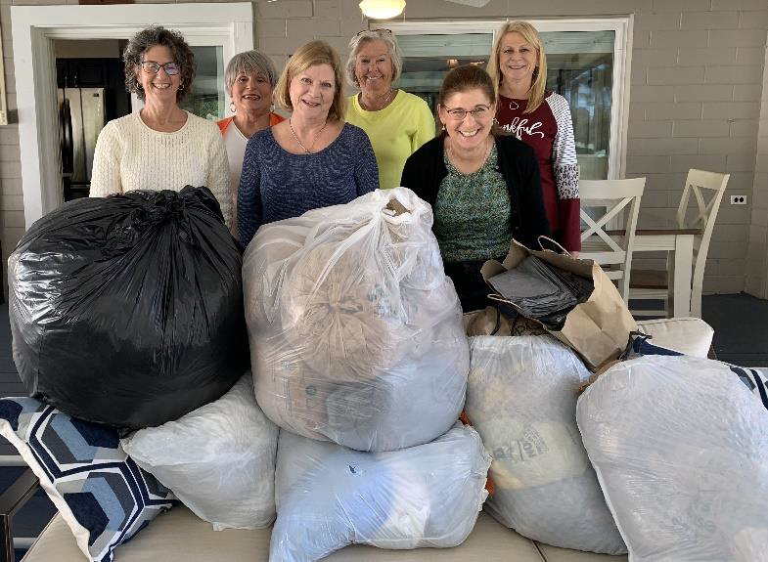
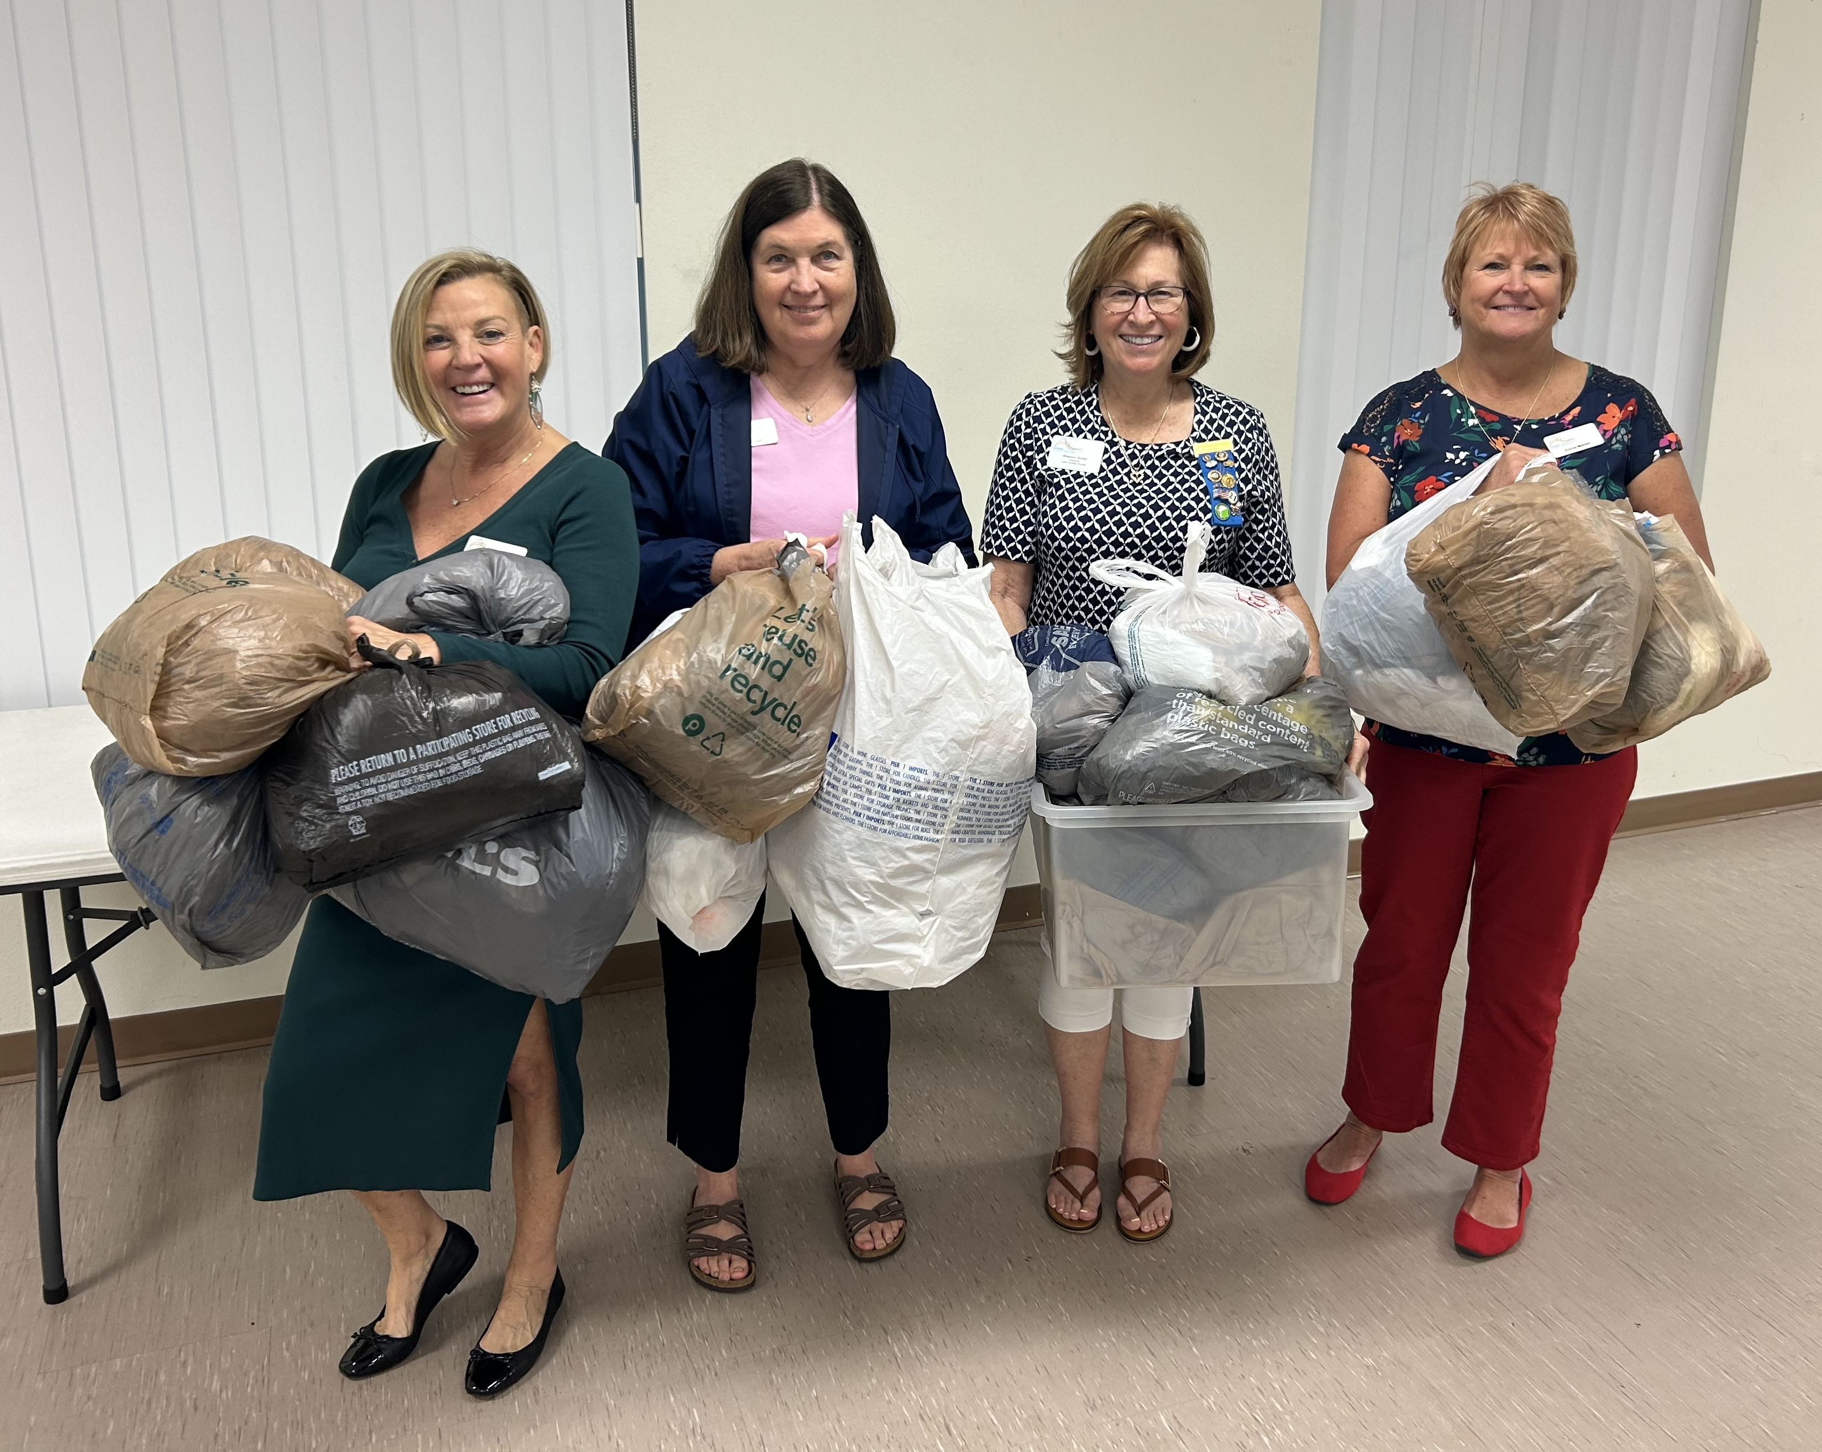
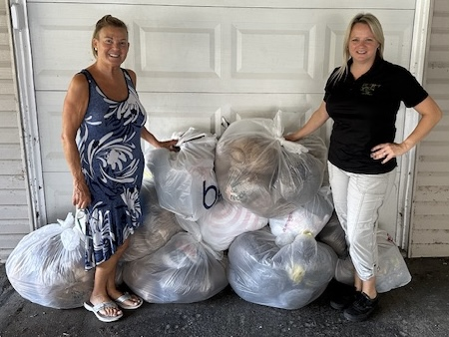
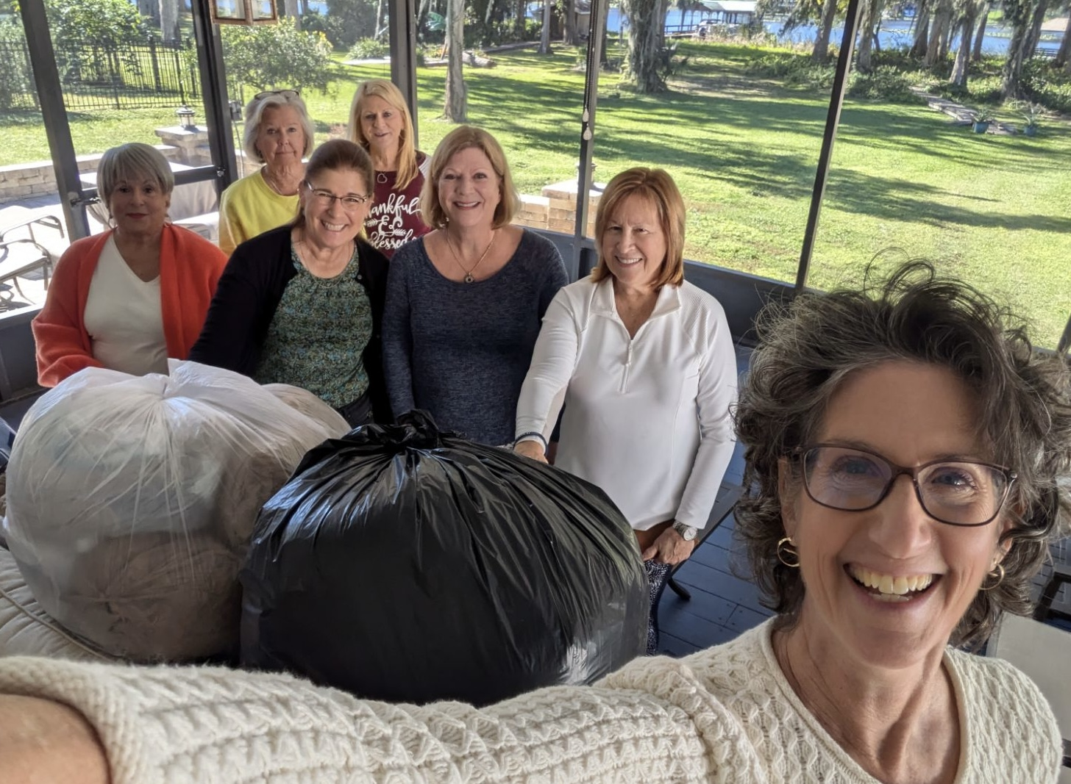

Slide 14
Wilma B. Hogan
Literacy Service Award
3rd Place
Raleigh, North Carolina
229 Points
Multi-Generational Literacy Project
Notes:
Altrusa International of Raleigh chose a multi-tiered approach to meeting literacy needs in their community. By providing books for infants, preschoolers, and adults the club sought to provide reading materials and promote literacy to multiple age groups, while contributing to literacy in their community.
Congratulations to Raleigh

Slide 15
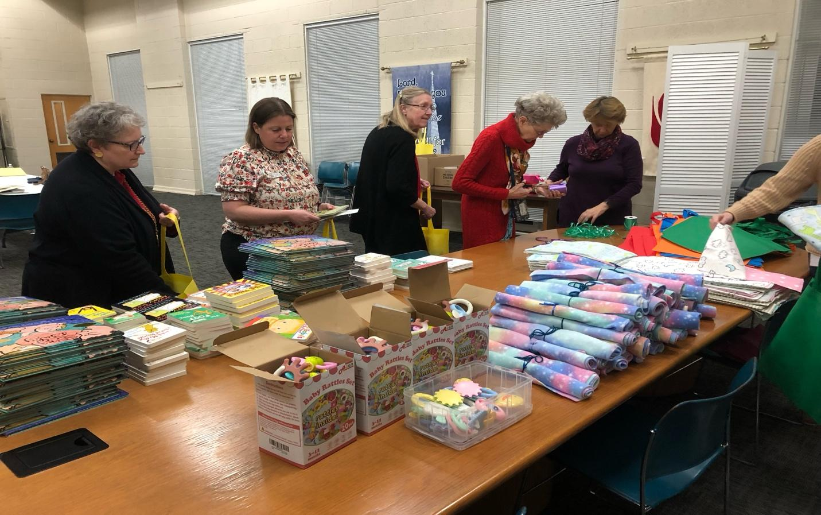

Slide 16
Wilma B. Hogan
Literacy Service Award
2nd Place
Lake County, Florida
251 Points
Read to Succeed
Notes:
The Lake County club’s mission is to promote literacy among disadvantaged children. With their “Read to Succeed” project they partnered with the Leesburg Police Department, participating in the community’s National Night Out, distributing over 800 books into the hands of Lake County’s children.
Congratulations to Lake County

Slide 17
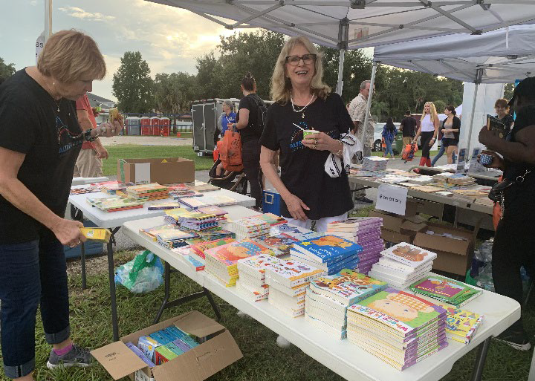

Slide 18
Wilma B. Hogan
Literacy Service Award
1st Place
Charlotte, North Carolina
261 Points
Banishing Book Deserts
Notes:
Altrusa and ASTRA Clubs of Charlotte collected over 800 new and gently used books to be distributed directly to students living in book deserts in the local community. This project was in direct support of Promising Pages, a Charlotte-based national charity. The main book collection period was in October to align with Promising Pages “Booktoberfest” but the clubs collected books all year long. As an added benefit, the literacy project promoted awareness of Altrusa and ASTRA in their community and the event reached close to 1,000 people.
Congratulations to Charlotte

Slide 19
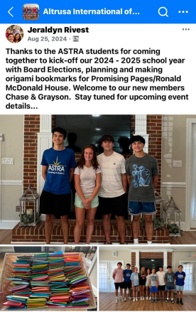

Slide 20
Vocational Services
Award
3rd Place
Gainesville, Florida
353 Points
Displaced Homemaker Program
Notes:
Established in 1984 at Santa Fe College in Gainesvillle, the Displaced Homemaker Program assists women who have experienced a life-changing event and need to enter the workforce. The Gainesville club has long supported this program with funding, food and clothing drives.
Congratulations to Gainesville

Slide 21
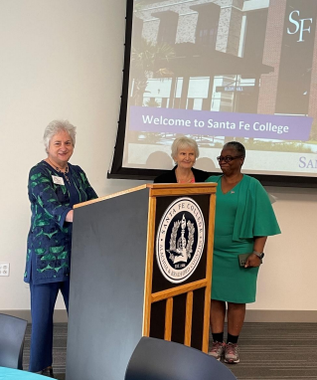

Slide 22
Vocational Services
Award
2nd Place
Lake County, Florida
364 Points
Brighter Futures Scholarships
Notes:
The Lake County “Brighter Futures” Scholarships seek the neediest of women to help them enter or re-enter the workforce. The club assists them on their journeys to a brighter future through education to create a better life for themselves and their families, and to become more successful and productive members of the community.
Congratulations to Lake County

Slide 23
Vocational Services
Award
1st Place
Spartanburg, South Carolina
383 Points
The Eula Sherman Vocational Scholarship
Notes:
The Eula Sherman Scholarship was named for the late Mrs. Sherman, a charter member of Altrusa of Spartanburg. Each Eula Sherman Scholarship assists a non-traditional students who is a Spartanburg County resident and is enrolled in an accredited institution of higher education. Since the inception of the scholarship, the club has awarded 104 scholarships, totaling $84,000. This year two $1,500 scholarships were awarded at an dinner in honor of the recipients, where the winners discussed their academic achievements and personal goals.
Congratulations to Spartanburg

Slide 24
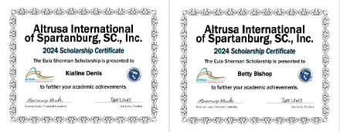

Slide 25
Cassie S. Dollar Rehabilitative Service Award
3rd Place
Lake City, Florida
317 Points
Full Tummies, Full Attention: Backpack Project
Notes:
The Lake City club’s Backpack Project partners with their local school system through the Homeless Education Initiative. Every 2 weeks during the school year, backpacks are filled healthy, easy to prepare foods and supplied to two Columbia County schools.
Congratulations Lake City

Slide 26
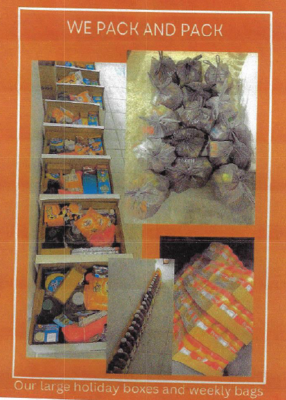

Slide 27
Cassie S. Dollar Rehabilitative Service Award
2nd Place
Charlotte, North Carolina
341 Points
A Little Bit of Faith
Notes:
Changed Choices is an organization which helps women who have experienced incarceration to reintegrate back into society. The Charlotte club has worked with Changed Choices for the last six years, by providing a helping hand and showing participants that a “Little Bit of Faith” in them can go a long way. Club members created Welcome Home kits, which included letters of encouragement, fleece blankets, toiletry items, journals, pens and inspirational books.
Congratulations Charlotte

Slide 28
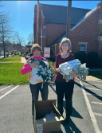
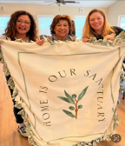

Slide 29
Cassie S. Dollar Rehabilitative Service Award
1st Place
Raleigh, North Carolina
345 Points
Wake County VIPs
(Visually Impaired Persons)
Notes:
Since 2022, Raleigh club members have assisted the Wake County Visually Impaired Persons (or VIPs). The members attend the monthly VIP meetings to assist with set-up, programs, and refreshments. The members also read bank statements, collect dues, and assist with other group activities. The members have accompanied VIPs on field trips to the North Carolina Museum of Art, the North Carolina History Museum, a local art gallery and to local restaurants. They provide transportation when needed and hosted a holiday luncheon in December. The VIPs’ former president stated that, “Our Altrusa volunteers are the “eyes” of our support group. We appreciate the kind and warm environment provided by the club members.”
Congratulations Raleigh

Slide 30
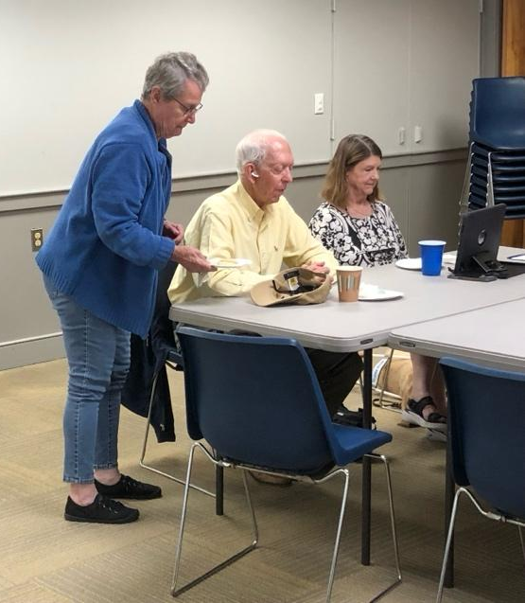
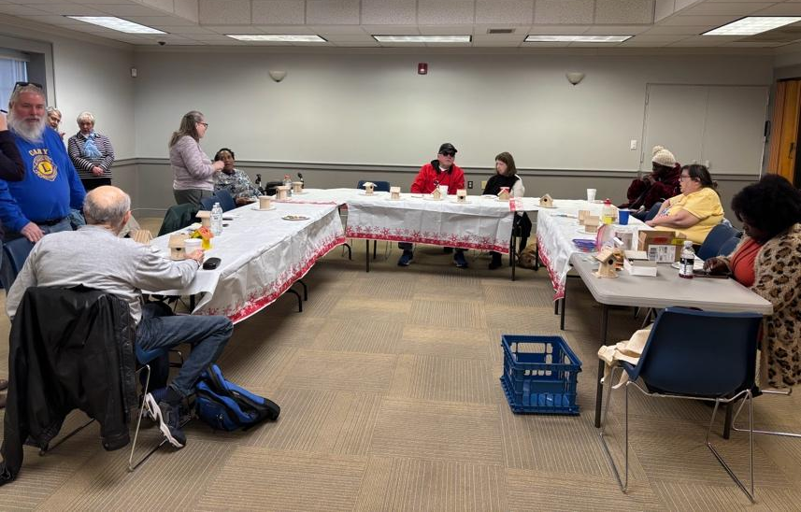

Slide 31
Altrusa District Three Foundation Awards 1st Place
1. Lucille Spillers Alexander ASTRA Award
Lake City, Florida - RSGA Red Carpet Event
2. Richard Ward Ulrich Environmental Service Award
Lake County, Florida - “Bag Recycling” – Cleaner Future for Florida
3. Wilma B. Hogan Literacy Service Award
Charlotte, NC – Banishing Book Deserts
4. Vocational Services Award
Spartanburg, SC – The Eula Sherman Vocational Scholarship
5. Cassie S. Dollar Rehabilitative Service Award
Raleigh, NC - Wake County VIPs (Visually Impaired Persons)
Notes:
Congratulations to all of our Foundation Awards winners, especially to our first place winners, listed again here.

Slide 32
Thank you for all the outstanding projects that you support in your communities!!

